Slide 1
Electricity Demand
Demand Side Analytics
Sri “Akhil” Jonnalagadda
06/15/2021

Slide 2
Overview
Premise
Takeaways
Infrastructure planning is based on electric peak demands
How does seasonality change demand?
Is demand tied to a time trend?
What is the weather and electric demand relationship?
Can we predict the electric demand?
Electric Demand rises with temperature and dew point
Summer and Winter spikes electric demand
Weekdays and Working hours have higher demand
Forecasts predict peak demands of ~1700 MW

Slide 3
Data
Weather data set:
Hourly Data from 01/2013 to 12/2017, ~80,000 Obs
Temperature, Dew point, Wind Direction*, Wind Speed**, and Sky Condition**
Electric Demand data:
Hourly Data from 01/2016 to 12/2017, ~17,500 Obs
MegaWatts(MW)
Data Clean
Data from 01/2016 to 12/2017
Temperature, Dew point, MW
Weekly running average is used
Electric Demand*** is shown by Megawatts (MW)
*Removed to incomplete data
**No correlation
***Electricity is a utility , quantity represents demand

Slide 4
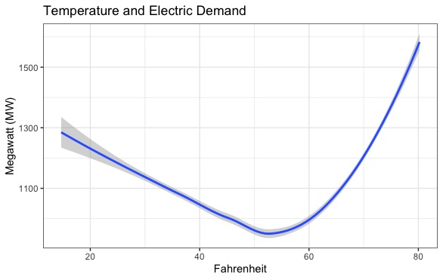
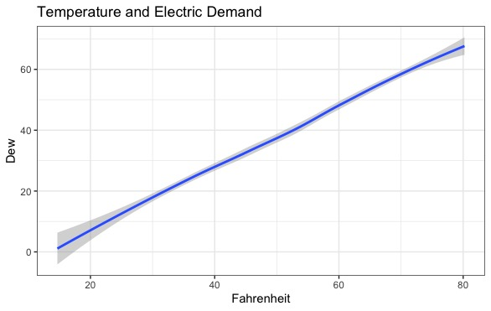
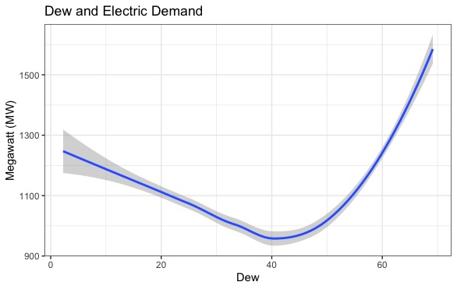
Weather and Electric Demand
We see a tight correlation between electric demand, Temperature and Dew
Low temperatures require heating and high temperatures require cool ie peaks of electric demand
Temperature and Dew are positively correlated

Slide 5
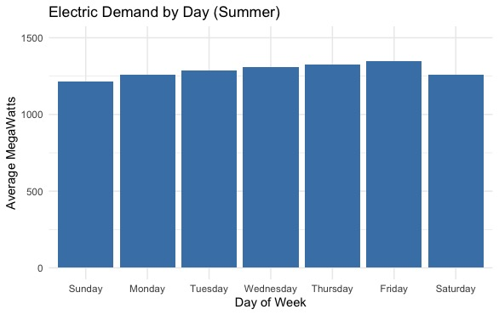
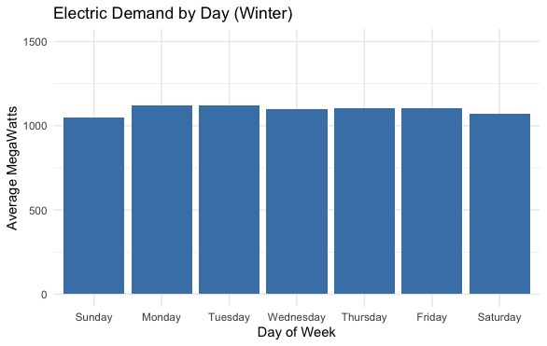
Electric Demand and Day
Electric Demand rises by ~100 MW on weekdays
Trend holds year round
Summer months (hotter) have a higher demand than winter months (colder)

Slide 6
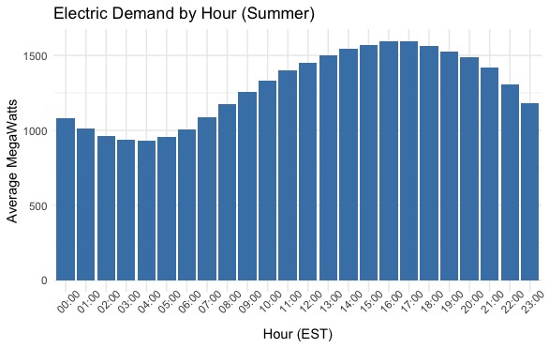
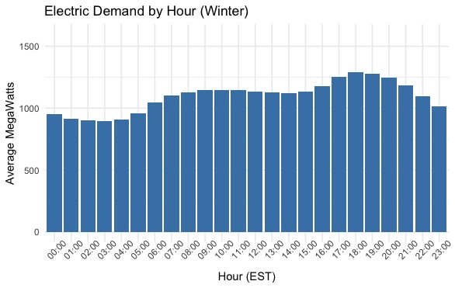
Electric Demand and Time
Waking Hours* had a increase in demand, ~60% of day
Summer Electric Demand rises by ~500 MW during waking hours*
Winter Electric Demand rises by ~300 MW during waking hours*
Summer months (hotter) have a higher demand than winter months (colder)
*8am-10pm

Slide 7
Demand Sensitivity
*Elasticity calculated using quadratic fit and average values
**Through Z-Test at .05 level
***Through F-Test at .05 level
Temperature ~ Electricity Price elasticity* is inelastic (.015)
Dew ~ Electricity Price elasticity* is inelastic (.019)
Summers have significantly** higher electric demand by day than winters
Summers have significantly*** higher electric demand by hours than winters

Slide 8
Model Walk
Simple Time Series Regression
Variables limited* to Temperature and Dew
Training Data from 2016-2017
Test Data from 2016-2017
Forecast Data from 2013-2016
Model:
Forecast_MW =
1731+ (-28.76 × Temperature) + (.3321 × Temperature²) + (-6.328 × Dew) +(.06838 × Dew²)
*Due to correlation and model fitting

Slide 9
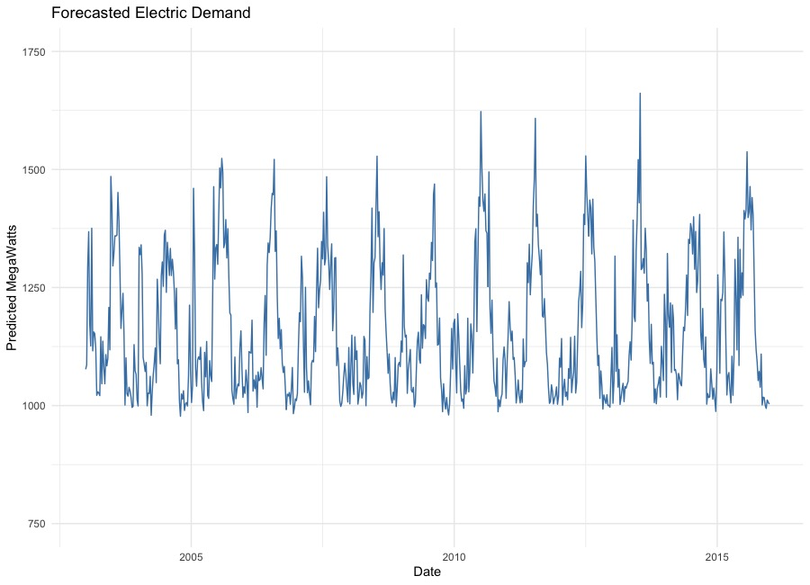
Forecast
The seasonality trend over time as expected
Lower bound of ~1000 MW and an upper bound of ~1700 MW
R^2 of .57 and RSME of 3.73

Slide 10
Closing thoughts
Takeaways
Electric Demand has weather, seasonality, weekly and hourly trends
Electric Demand is inelastic
Summers have higher demand than winters
Forecasts predict peak demands of ~1700 MW
Question?

